Slide 1
ICA PRESENTATION
AMNA SHAH
24750

Slide 2
ALL
ABOUT
ME

Slide 3
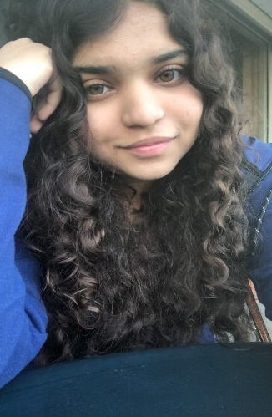
Who am I?
I am currently 19 years old. I was born on the 28th of February, 2002.
And I’m now currently studying at the IBA.
My name is Amna Shah
I was born in Karachi, Pakistan in Agha Khan Hospital.
My father did his BBA and MBA and worked in Sales and Marketing.
That’s me →
I attended the Convent of Jesus and Mary from Prep 2 to Class 11. I did my O Levels from here.
I then went to The Lyceum School for two years for my A Levels.
My mother did dentistry and is a housewife. I have two younger brothers.

Slide 4
HERE ARE SOME THINGS I ENJOY.
WRITING IN MY JOURNAL
WRITING IN GENERAL
READING BOOKS, INCLUDING SELF-HELP ONES
LISTENING TO MUSIC
COLLECTING STATIONERY
MOBILE AND PC GAMING – ADVENTURE GAMES ARE MY FAVOURITE
WATCHING YOUTUBE VIDEOS AND LISTENING TO PODCASTS
DANCING AND SINGING (ALONE ☺)

Slide 5
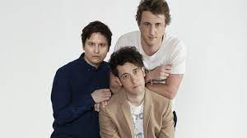
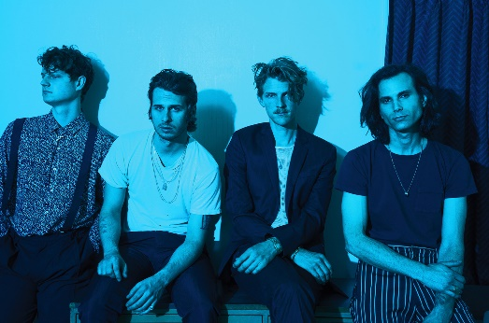
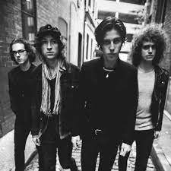
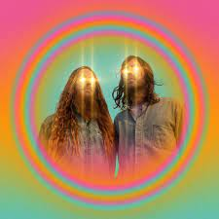
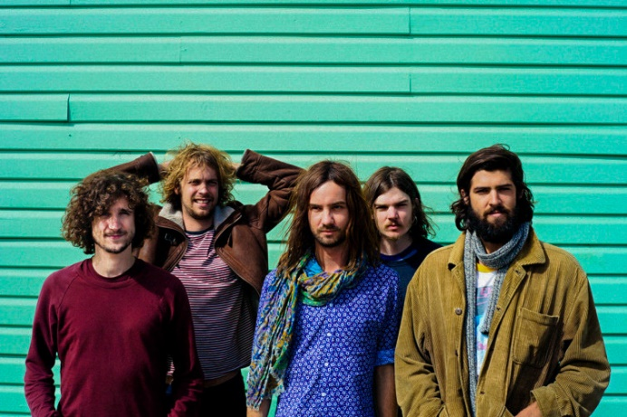
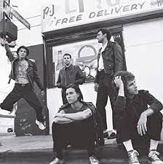
Here are some of my favourite bands. I mostly listen to English indie, rock or alternate bands.
FOSTER THE PEOPLE
THE WOMBATS
KUZNITE
TAME IMPALA
CATFISH AND THE BOTTLEMEN
THE NEIGHBOURHOOD

Slide 6
HERE ARE 5 FUN FACTS ABOUT ME
1. I STILL HAVEN’T GOTTEN MY EARS PIERCED. I PLAN TO DO SO NEXT YEAR.
3. My three favourite colours are pink, purple and bright yellow.
2. In school, my best subjects were English language and English literature. I was always the top in class and people assumed I was going to be a writer or journalist when I grew up. I even took literature in a levels because my mom encouraged me to. However I decided to do bba ☺
4. my worst subject is maths. I got a b in o levels, but through sheer hard work studied it for the iba test…and was 3 mcqs short. I then gave the sat, and got a 610. maths and me have been feuding since grade 6 ☺
5. I cry very easily and every day. Any touching or sad video makes me cry. It’s why I don’t think I could be a psychologist as I absorb the pain of others.

Slide 7
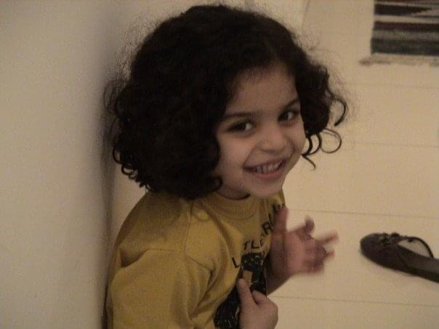
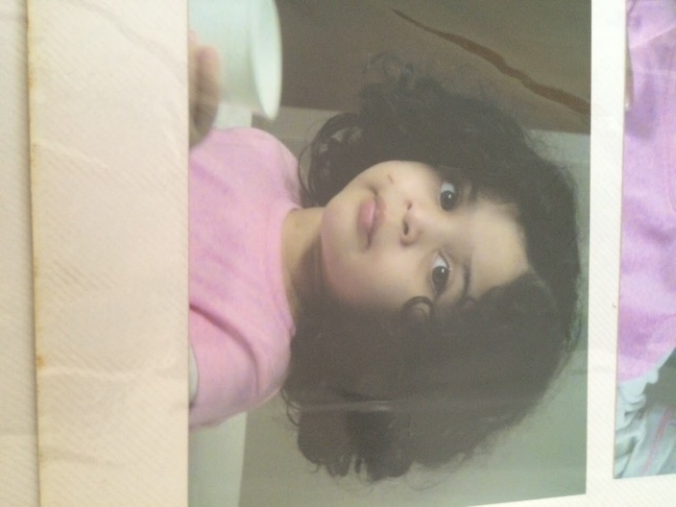
Here are 3 childhood memories
I lived in Sharjah, U.A.E. for two or so years when I was 3-4 ☺ I remember going to Dubai Mall, Dubai Zoo, Desert Safaris and waterparks. I would feed fish in the river.
I also lived in Islamabad while I was very young. It was very cold. I remember we had a talking parrot which could mimic people, the doorbell and ringtones!
I remember sticking my head out of my car as a kid and screaming-singing Pakistani songs like “Ye Watan Humara Hai” one Independence Day long ago ☺Other cars were playing patriotic music too. It was a time when love for the nation was a lot higher and lot more positive.

Slide 8
HERE ARE 5 MORE FUN FACTS ABOUT ME
1. I WANT TO BE A MOTIVATIONAL SPEAKER WHEN I GROW UP, LIKE TONY ROBBINS, QASIM ALI SHAH, ETC.
2. I was the world’s biggest harry potter fan and even bought merchandise from international stores. My dream is to go to harry potter world one day.
3. one of my favourite movies is “dead poet’s society” due to it’s artistic nature.
4. I WANTED TO BE AN INTERIOR DECORATOR WHEN I WAS YOUNGER. I WAS REALLY REALLY INTO IT.
5. MY TWO TOP BOOKS: “A THOUSAND SPLENDID SUNS” BY KHALED HOUSSENI AND “I’LL GIVE YOU THE SUN” BY JANDY NELSON.

Slide 9
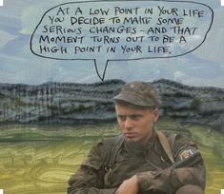
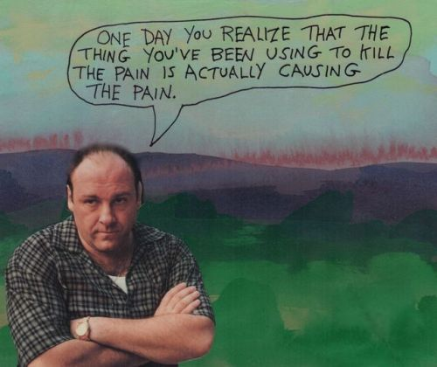
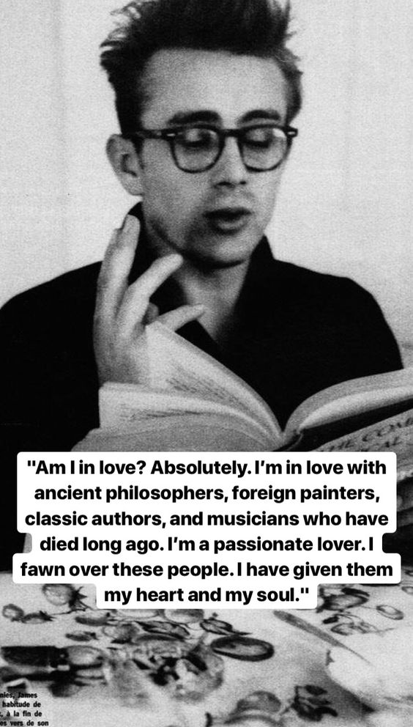
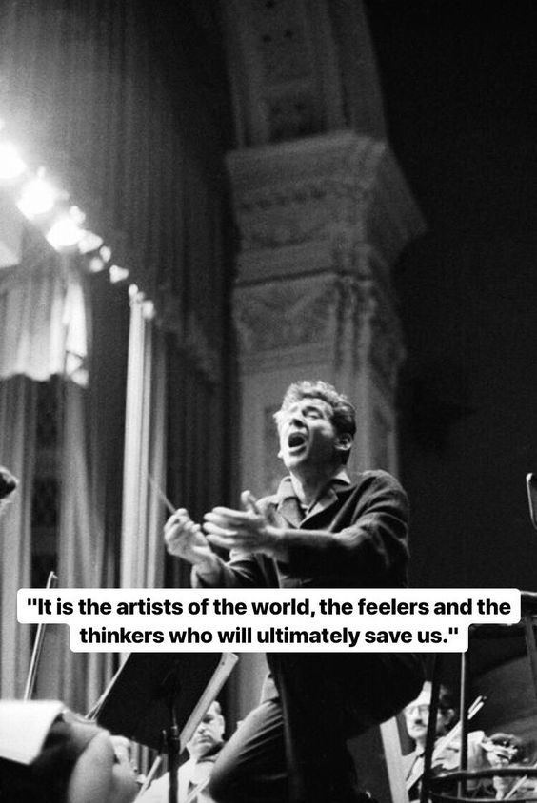
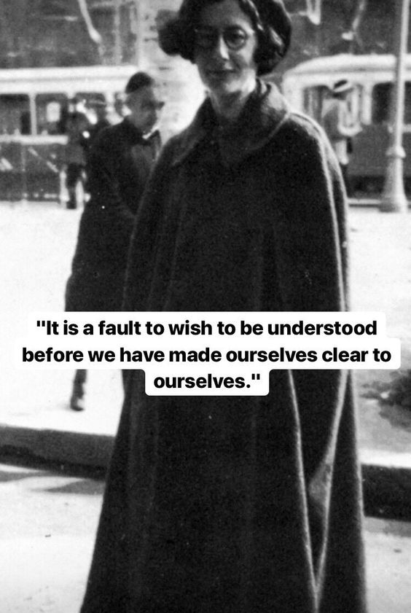
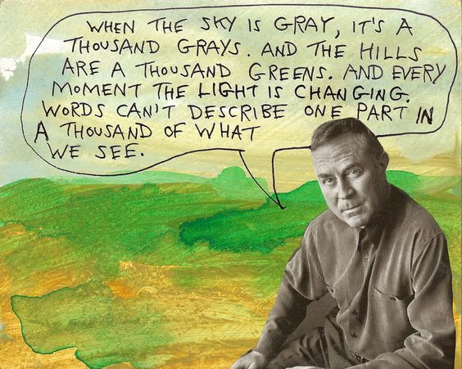
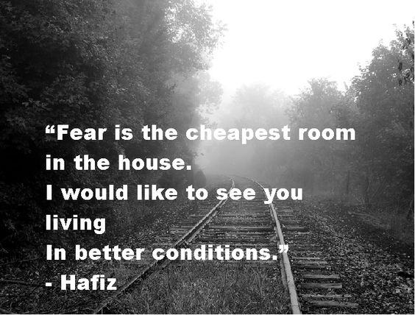
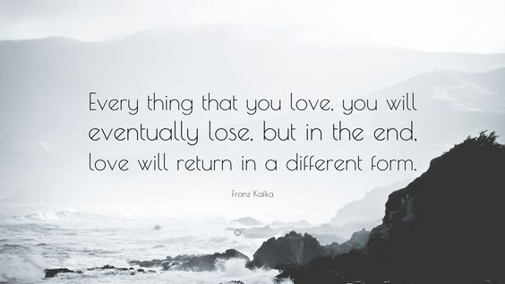
Some of My favourite quotes
AND
THEY
TELL
A LOT
ABOUT ME
WHAT I LOVE

Slide 10
MY INTERESTS
THINGS I HATE
NUMBERS
CHORES
INSECTS
THE COLOUR GREY
CHIC FLIC FILMS
ONLINE CLASSES
COMMUNISM
CAPITALISM
ASTROLOGY
PHILOSOPHY
Rumi quotes
CREATIVE WRITING
CONSUMER PSYCHOLOGY
ROOM DÉCOR
TRAVELLING
CONTENT CREATION

Slide 11
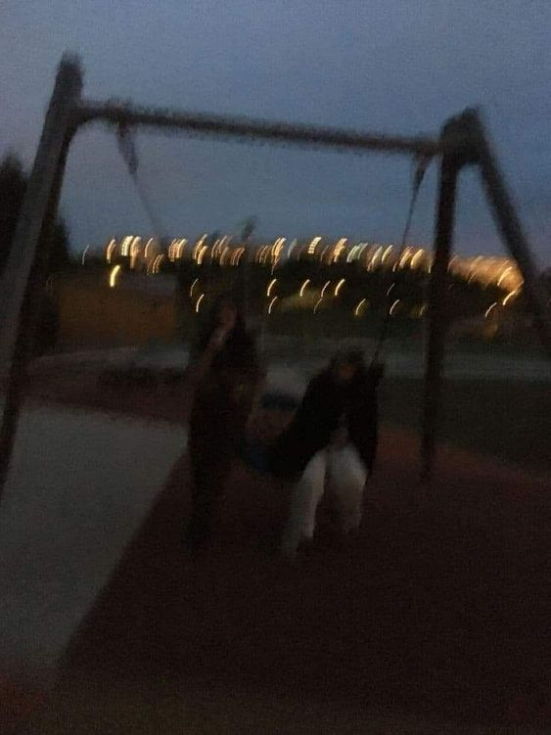
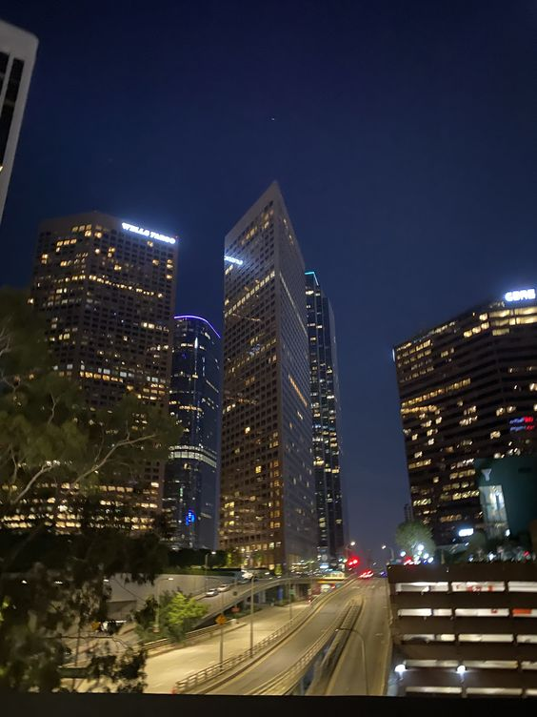
MY DREAMS
Travelling a lot
Being a motivational speaker
Living in a big metropolitan city one day with beautiful buildings and lights and hustle and bustle.
Publishing a book
Living in a huge house and having multiple pets.
Being creative and getting recognition for it

Slide 12
My thoughts on ica course
There Was a lot of typing involved
I wish we spent more time on powerpoint ☺
Taught me a lot about word and excel however
Wish we did some creative things too like making videos
Workload was manageable
Learnt new things e.g. git, pivot tables, etc.

Slide 13
THANK YOU FOR WATCHING ☺
P.S. ANOTHER THING I LOVE: GOOD GRADES ☺

